Slide 1
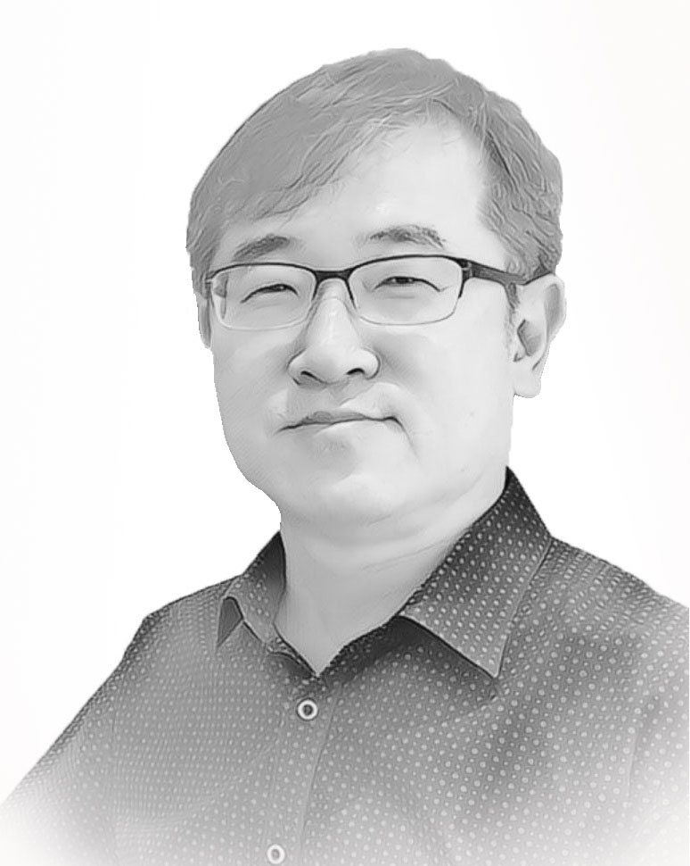
Laravel 실무 따라하기
11장. Tips
2022.3 ∼ 2022.6
인덕대학교
컴퓨터소프트웨어학과
교수 윤형태

Slide 2
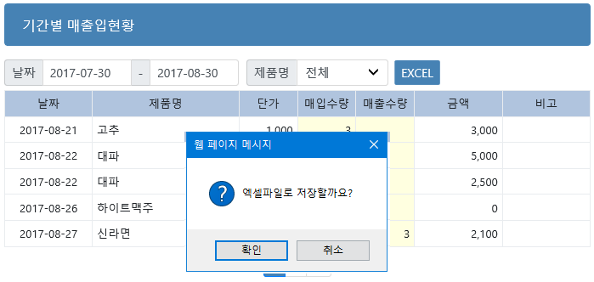
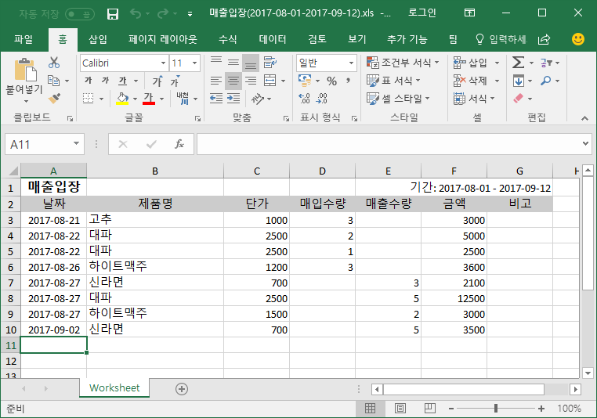
1. Excel 로 저장하기

Slide 3
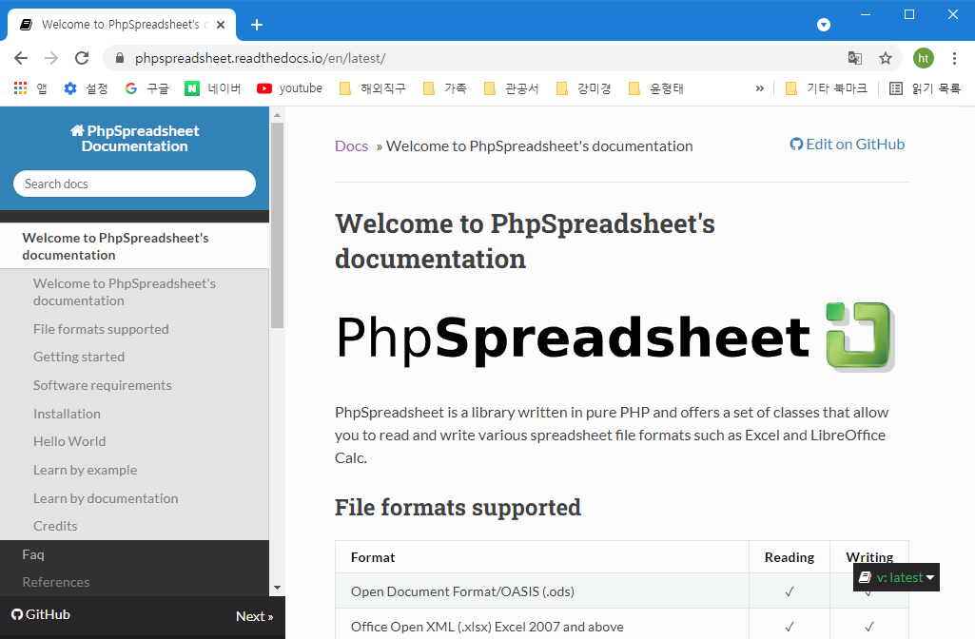
PhpSpreadsheet
1) 설치 : composer require phpoffice/phpspreadsheet
2) 사용할 Controller 프로그램 첫 줄에 다음 선언
require "../vendor/autoload.php";
use PhpOffice/PhpSpreadsheet/IOFactory;
use PhpOffice/PhpSpreadsheet/Spreadsheet;

Slide 4

<input type="button" value="EXCEL" class="form-control btn btn-sm mycolor1"
onClick="if (confirm('엑셀파일로 저장할까요?')) make_excel();">
function make_excel()
{
form1.action="{{ url('gigan.excel') }}";
form1.submit();
}

Slide 5
엑셀로 저장하는 자료 → 전체자료 필요
public function getlist_all( $text1, $text2, $text3 )
{
if ($text3==0) // 제품이 전체인 경우
$result = Jangbu::leftjoin('products','jangbus.products_id','=','products.id')->
select('jangbus.*','products.name as products_name')->
wherebetween('jangbus.writeday', array($text1,$text2))->
orderby('jangbus.id','desc')->get();
else
$result = Jangbu::leftjoin('products','jangbus.products_id','=','products.id')->
select('jangbus.*','products.name as products_name')->
wherebetween('jangbus.writeday', array($text1,$text2))->
where('jangbus.products_id',"=",$text3)->
orderby('jangbus.id','desc')->get();
return $result;
}

Slide 6
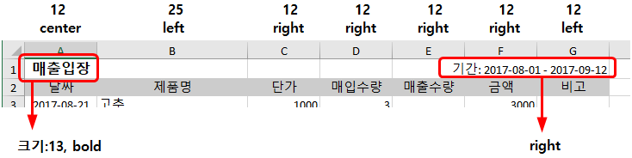
열(너비,정렬), 제목부 정의
$sheet = new Spreadsheet();
$sheet->getActiveSheet()->getColumnDimension("A")->setWidth(12); // 각 칼럼 (너비)
$sheet->getActiveSheet()->getColumnDimension("B")->setWidth(25);
…
$sheet->getActiveSheet()->getColumnDimension("G")->setWidth(12);
$sheet->getActiveSheet()->getStyle("A")->getAlignment()->setHorizontal("center"); // 각 칼럼 (정렬)
$sheet->getActiveSheet()->getStyle("B")->getAlignment()->setHorizontal("left");
$sheet->getActiveSheet()->getStyle("C:F")->getAlignment()->setHorizontal("right");
$sheet->getActiveSheet()->getStyle("G")->getAlignment()->setHorizontal("left");
$sheet->setActiveSheetIndex(0)->setCellValue("A1", "매출입장"); // 제목 (글자 크기, 굵게)
$sheet->getActiveSheet()->getStyle('A1')->getFont()->setSize(13);
$sheet->getActiveSheet()->getStyle('A1')->getFont()->setBold(true);
$sheet->setActiveSheetIndex(0)->setCellValue("G1", "기간: " . $text1 . " - " . $text2); // 기간 (정렬)
$sheet->getActiveSheet()->getStyle("G1")->getAlignment()->setHorizontal("right");

Slide 7
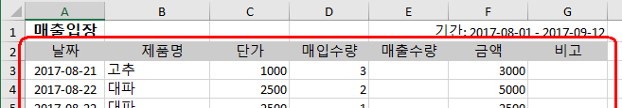
머리말, 자료 저장부분
// 2행 : 헤더 가운데 정렬
$sheet->getActiveSheet()->getStyle("A2:G2")->getAlignment()->setHorizontal("center");
// 헤더 배경색(밝은 회색)
$sheet->getActiveSheet()->getStyle("A2:G2")->getFill()
->setFillType(\PhpOffice\PhpSpreadsheet\Style\Fill::FILL_SOLID)
->getStartColor()->setARGB('FFCCCCCC');
// 헤더 글자 출력
$sheet->setActiveSheetIndex(0)
->setCellValue("A2", "날짜")
->setCellValue("B2", "제품명")
->setCellValue("C2", "단가")
->setCellValue("D2", "매입수량")
->setCellValue("E2", "매출수량")
->setCellValue("F2", "금액")
->setCellValue("G2", "비고");

Slide 8
$i=3;
foreach ( $list as $row ) // 3행부터 자료 출력
{
$sheet->setActiveSheetIndex(0)
->setCellValue("A$i",$row->writeday)
->setCellValue("B$i",$row->product_name)
->setCellValue("C$i",$row->price ? $row->price : "")
->setCellValue("D$i",$row->numi ? $row->numi : "")
->setCellValue("E$i",$row->numo ? $row->numo : "")
->setCellValue("F$i",$row->prices ? $row->prices : "")
->setCellValue("G$i",$row->bigo);
$i++;
}

Slide 9
파일이름, 저장
$sheet->setActiveSheetIndex(0);
$fname="매출입장($text1 - $text2).xlsx"; // 파일이름 생성
header("Content-Type: application/vnd.openxmlformats-officedocument.spreadsheetml. sheet");
header("Content-Disposition: attachment;filename=$fname");
header("Cache-Control: max-age=0");
$writer = PHPExcel_IOFactory::createWriter($sheet, "Xlsx"); // xlsx형식
$writer->save("php://output");
}

Slide 10
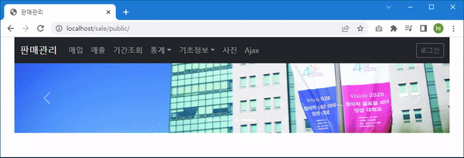
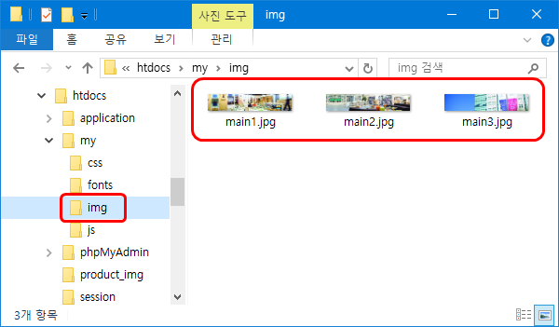
2. Slide
my/img 폴더 사진들

Slide 11
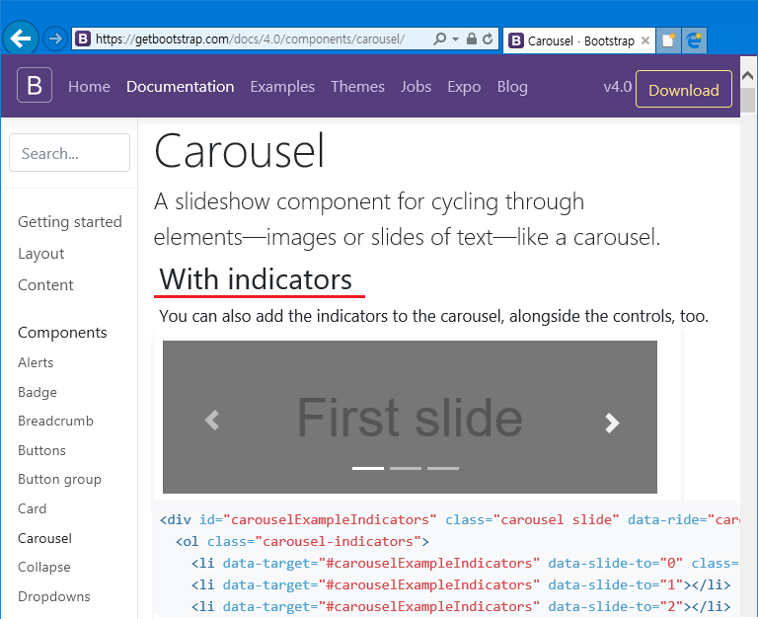
Bootstrap의 Carosel

Slide 12
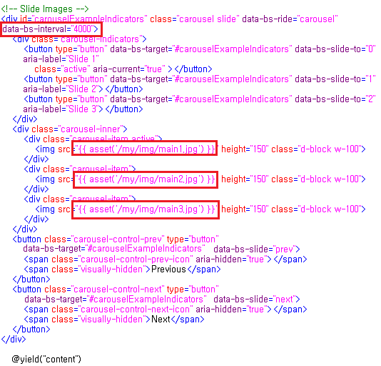
main.blade.php

Slide 13
<div id="carouselExampleIndicators" class="carousel slide" data-bs-ride="carousel" data-bs-interval="4000">
<div class="carousel-indicators">
<button type="button" data-bs-target="#carouselExampleIndicators" data-bs-slide-to="0" aria-label="Slide 1"
class="active" aria-current="true" ></button>
<button type="button" data-bs-target="#carouselExampleIndicators" data-bs-slide-to="1" aria-label="Slide 2"></button>
<button type="button" data-bs-target="#carouselExampleIndicators" data-bs-slide-to="2" aria-label="Slide 3"></button>
</div>
<div class="carousel-inner">
<div class="carousel-item active">
<img src="{{ asset('/my/img/main1.jpg') }}" height="150" class="d-block w-100">
</div>
<div class="carousel-item">
<img src="{{ asset('/my/img/main2.jpg') }}" height="150" class="d-block w-100">
</div>
<div class="carousel-item">
<img src="{{ asset('/my/img/main3.jpg') }}" height="150" class="d-block w-100">
</div>
</div>
<button class="carousel-control-prev" type="button" data-bs-target="#carouselExampleIndicators" data-bs-slide="prev">
<span class="carousel-control-prev-icon" aria-hidden="true"></span>
<span class="visually-hidden">Previous</span>
</button>
<button class="carousel-control-next" type="button" data-bs-target="#carouselExampleIndicators" data-bs-slide="next">
<span class="carousel-control-next-icon" aria-hidden="true"></span>
<span class="visually-hidden">Next</span>
</button>
</div>

Slide 14
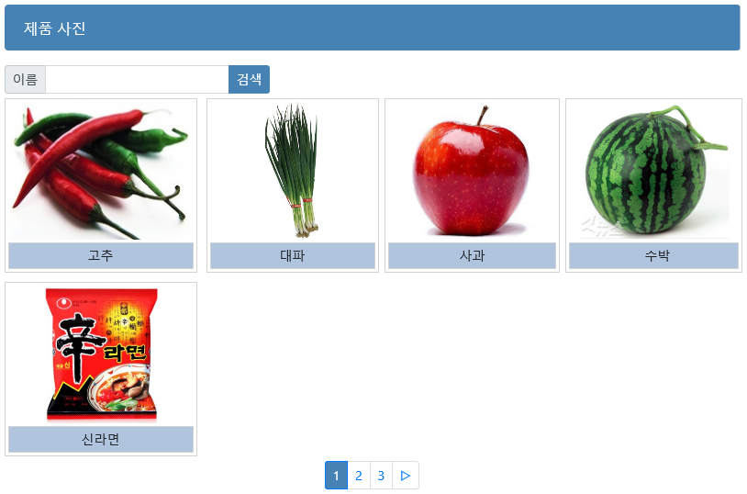
3. Gallery 만들기
poduct _img 폴더 사진들

Slide 15
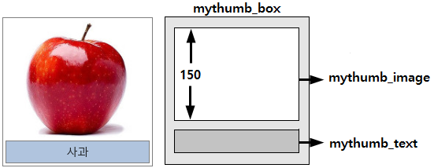
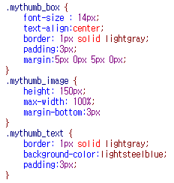
my.css 에 정의

Slide 16
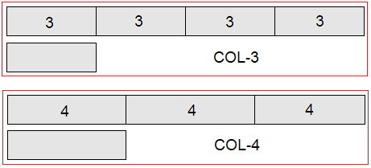
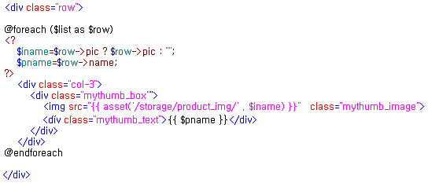
2차원구조 사진 표시부분

Slide 17
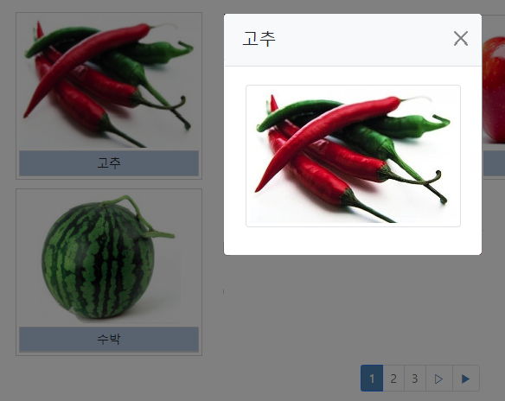
4. 확대사진 만들기
My폴더의 /my.css
.mythumb_bigimage {
height: 550px;
max-width: 100%;
margin-bottom:3px
}

Slide 18
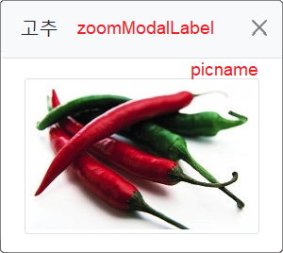
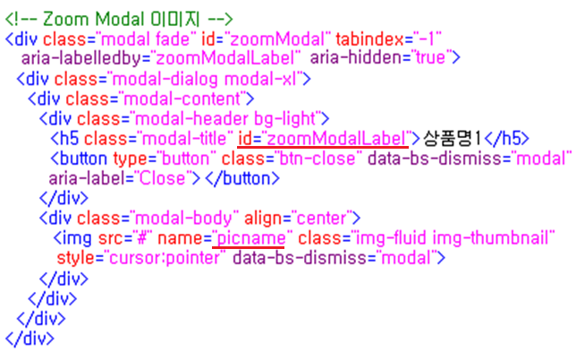
사진표시용 Modal 창

Slide 19
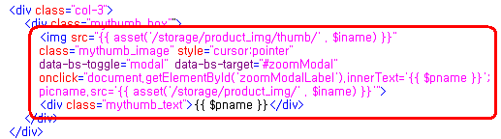
제품명 ➜ document.getElementById('zoomModalLabel').innerText;
사진 ➜ picname.src='그림파일이름';

Slide 20
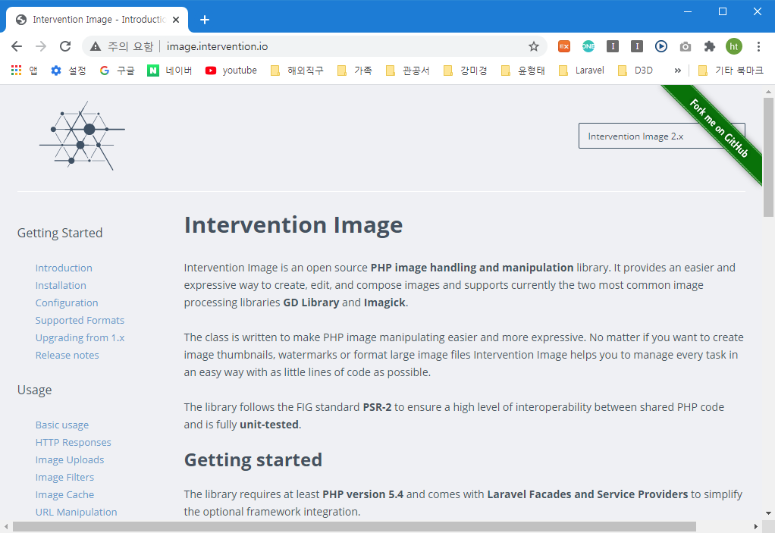
5. Thumbnail Image 만들기
Intervention/Image 라이브러리 → thumbnail 자동생성
설치 : composer require intervention/image
사진 폴더 : sale/storage/app/public/product_img
thumbnail 폴더 : sale/storage/app/public/product_img/thumb
→ chmod 777

Slide 21
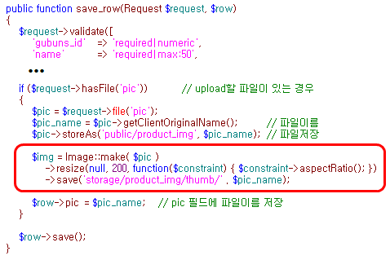

Slide 22
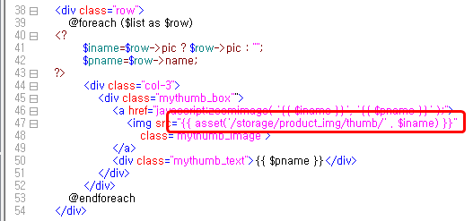

Slide 23
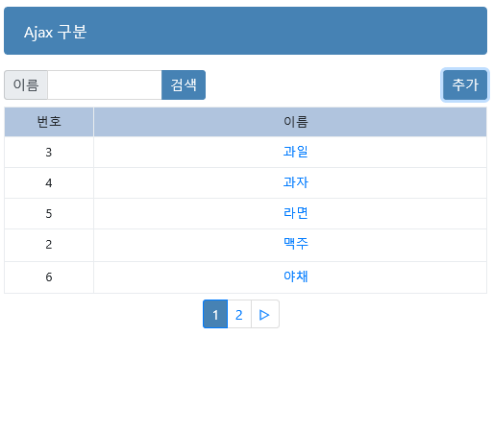
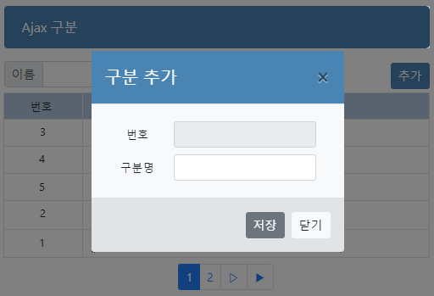
6. Ajax 구분
목록화면에서 삭제처리 → 보기화면(view) 불필요
gubun 복사하여 ajax 만듬

Slide 24
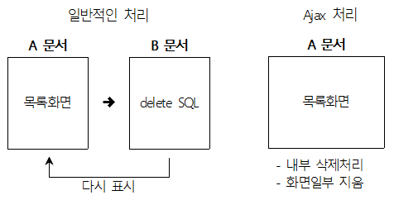
6-1. Ajax (Asynchronous Javascript And XML) :
웹브라우저와 웹서버 간에 내부적인 처리가 가능하여, 다시 화면을 실행하지 않고도 화면의 내용을 추가, 삭제, 변경할 수 있는 기술

Slide 25
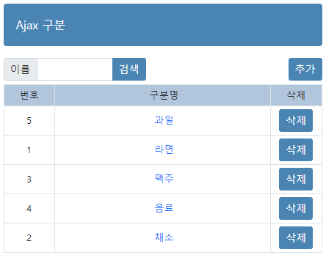
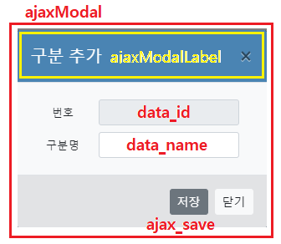
6-2. 구분 기본 만들기
ajax_add
disable
table_list
ajax_del

Slide 26
<!-- Ajax Modal : Gubun --> <div class="modal fade" id="ajaxModal" tabindex="-1" aria-labelledby="ajaxModalLabel" aria-hidden="true"> <div class="modal-dialog modal-sm"> <div class="modal-content"> <div class="modal-header mycolor1"> <h5 class="modal-title" id="ajaxModalLabel">구분 추가</h5> <button type="button" class="btn-close" data-bs-dismiss="modal" aria-label="Close"> </button> </div> <div class="modal-body bg-light"> <form name="form2" method="post" action=""> @csrf <table class="tablet table-sm table-borderless mymargin5"> <tr> <td width="30%">번호</td> <td width="70%" align="left"> <input type="text" name="id" id="data_id" class="form-control form-control-sm" disabled> </td> </tr> <tr> <td>구분명</td> <td> <input type="text" name="name" id="data_name" class="form-control form-control-sm"> </td> </tr> </table> </form> </div> <div class="modal-footer alert-secondary"> <button type="button" class="btn btn-sm btn-secondary" data-bs-dismiss="modal" id="ajax_save">저장</button> <button type="button" class="btn btn-sm btn-light" data-bs-dismiss="modal"> 닫기</button> </div> </div> </div> </div>

Slide 27
Jquery ajax함수 :
$.ajax({ headers: 토큰값, url: "문서", type: "POST or GET or PUT or DELETE …", data: { 변수명1:값1, 변수명2:값2, … }, dataType: "jason or text or html or xml …", success: function(data) { … } }); | // ajax용 보안 토큰 값 // 실행할 문서 // 값 전송방식 // 전송할 값들 // return 결과값의 데이터형식 // 성공 후, return값(data)

Slide 28
추가,수정,삭제를 위한 token 보안처리 :
<meta name="_token" content="{{ csrf_token() }}">
$.ajax({ headers: { "X-CSRF-TOKEN": $("meta[name='_token']").attr("content") }, url: "ajax", type: "POST", …

Slide 29

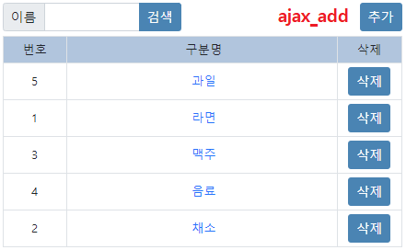
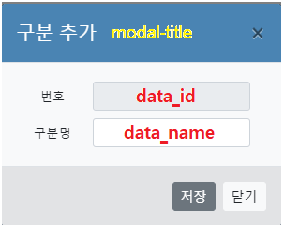
6-3. Ajax 추가

Slide 30
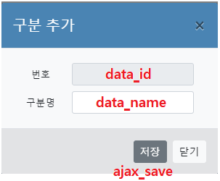
$(function() { $("#ajax_save").click( function() { var id=$("#data_id").val(); var name=$("#data_name").val(); $.ajax({ headers: {"X-CSRF-TOKEN": $("meta[name='_token']").attr("content")}, url: "ajax", type: "POST", data:{ name: name }, dataType: "json", success: function(data) { var id = data.id; $("#table_list").append( "<tr>"+ " <td>"+id+"</td>"+ " <td><a href='#'>"+name+"</a></td>" + " <td><a href='#' class='btn btn-sm mycolor1'>삭제</a></td>"+ "</tr>"); } }); }); });

Slide 31
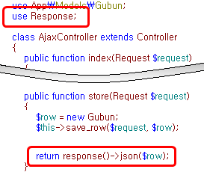
AjaxController의 store → 추가된 자료 json형식으로 리턴

Slide 32
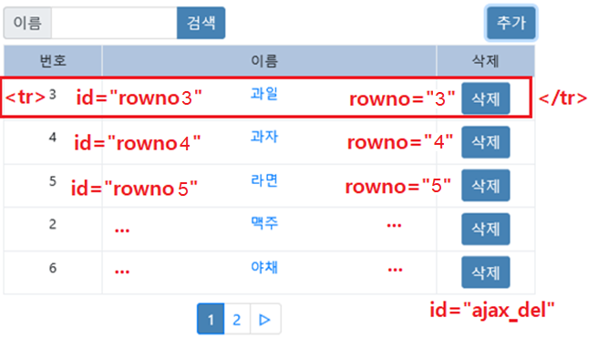

6-4. Ajax 삭제
Ajax 처리를 위한 id값 설정
AjaxController의 Destroy

Slide 33
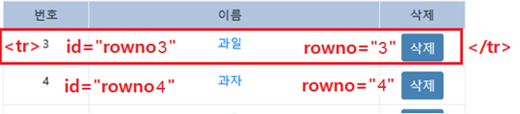
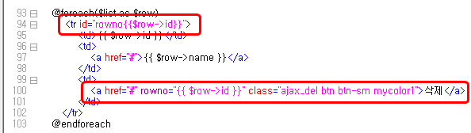
삭제를 위한 id 지정 :

Slide 34
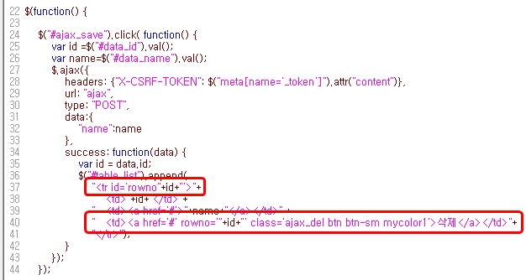
추가 저장버튼 jquery 수정 :

Slide 35
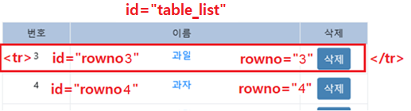
삭제 ajax jquery :
$("#table_list").on("click",".ajax_del",function() { if (confirm("삭제할까요 ?")) { var id=$(this).attr("rowno"); $.ajax({ headers: { 'X-CSRF-TOKEN': $('meta[name="_token"]').attr('content') }, url: "ajax/"+id, type: "POST", data: { _method: 'DELETE', }, success: function(data) { $("#rowno"+id).remove(); } }); }; });

Slide 36
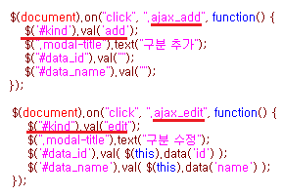
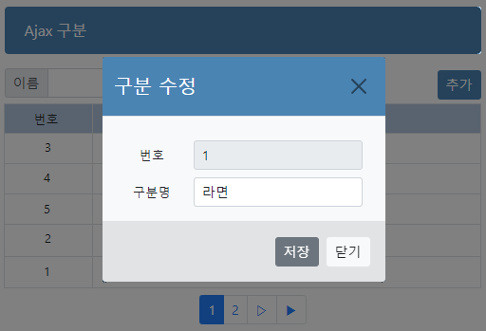
6-5. Ajax 수정
Modal창 재사용
<input type="hidden" name="kind" id="kind" value="">
• 추가 : kind="add" • 수정 : kind="edit"

Slide 37
$(function() {
$("#ajax_save").click( function() {
var id =$("#data_id").val();
var name=$("#data_name").val();
if ($("#kind").val()=="add")
{
추가를 위한 ajax
}
else
{
수정을 위한 ajax
}
});

Slide 38
수정을 위한 ajax
$.ajax({
headers: {'X-CSRF-TOKEN': $('meta[name="_token"]').attr('content')},
url: "ajax/"+id,
type: "POST",
data:{
_method: 'PATCH',
name:name
},
success: function(data) {
$("#rowno"+id).replaceWith(
"<tr id='rowno"+id+"'>"+
" <td>"+id+"</td>"+
" <td><a href='#ajaxModal' data-toggle='modal' data-target='#ajaxModal' class='ajax_edit' data-id='"+id+"' data-name='"+name+"'>"+name+"</a></td>"+
" <td><a href='#' rowno='"+id+"' class='ajax_del btn btn-sm mycolor1'>삭제</a></td>"+
"</tr>");
}
});

Slide 39
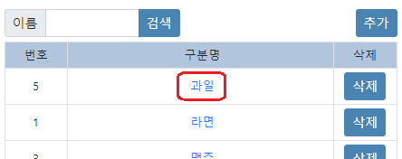
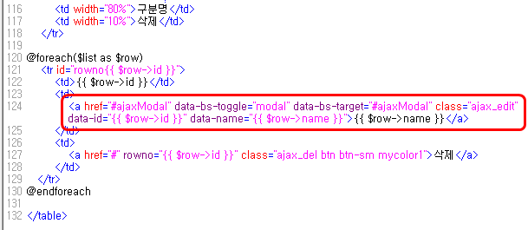

Slide 40
추가를 위한 ajax : 수정내용
$.ajax({
headers: {'X-CSRF-TOKEN': $('meta[name="_token"]').attr('content')},
… … …
$("#table_list).append(
"<tr id='rowno"+id+"'>"+
" <td>"+id+"</td>"+
" <td><a href='#ajaxModal' data-bs-toggle='modal' data-bs-target='#ajaxModal' class='ajax_edit' data-id='"+id+"' data-name='"+name+"'>"+name+"</a></td>"+
" <td><a href='#' rowno='"+id+"' class='ajax_del btn btn-sm mycolor1'>삭제</a> </td>"+
"</tr>");
… … …

Slide 41
AjaxCotroller의 Update
public function update(Request $request, $id) { $row = Gubun::find($id); $this->save_row($request, $row); }

